Slide 1
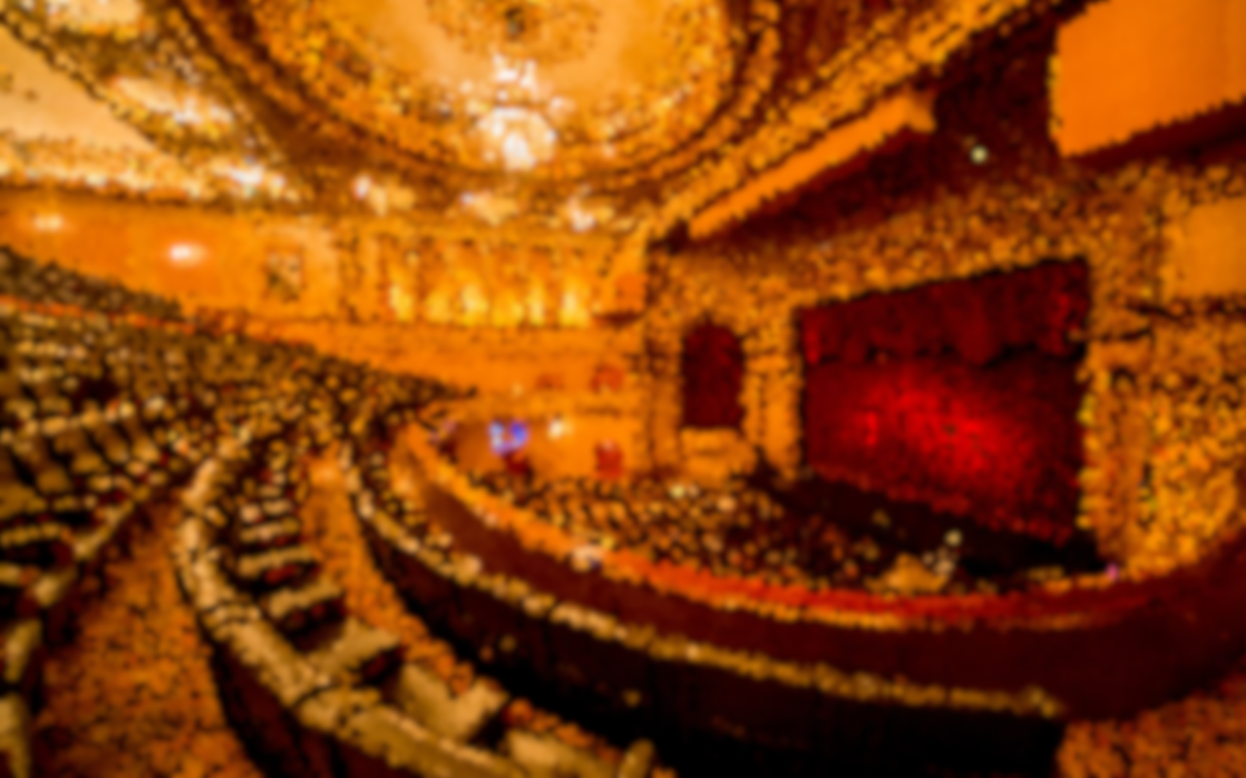
Automatic captioning synchronization in theatre
Author: Diego Carrero Figueroa
Tutor: Ascensión Gallardo Antolín
Master Degree in Multimedia and Communications

Slide 2
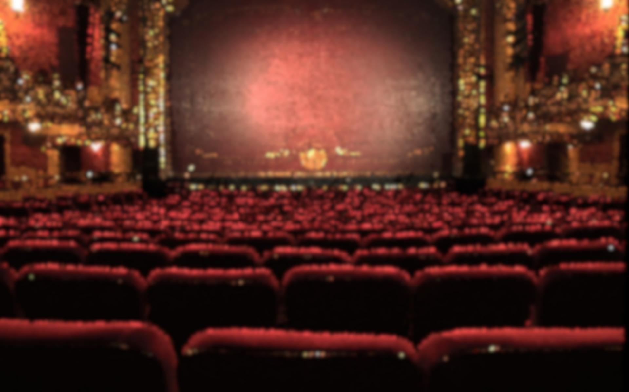
Motivation
Is it possible to use the smartphone as second screen to distribute the subtitling of a theatre play?

Slide 3
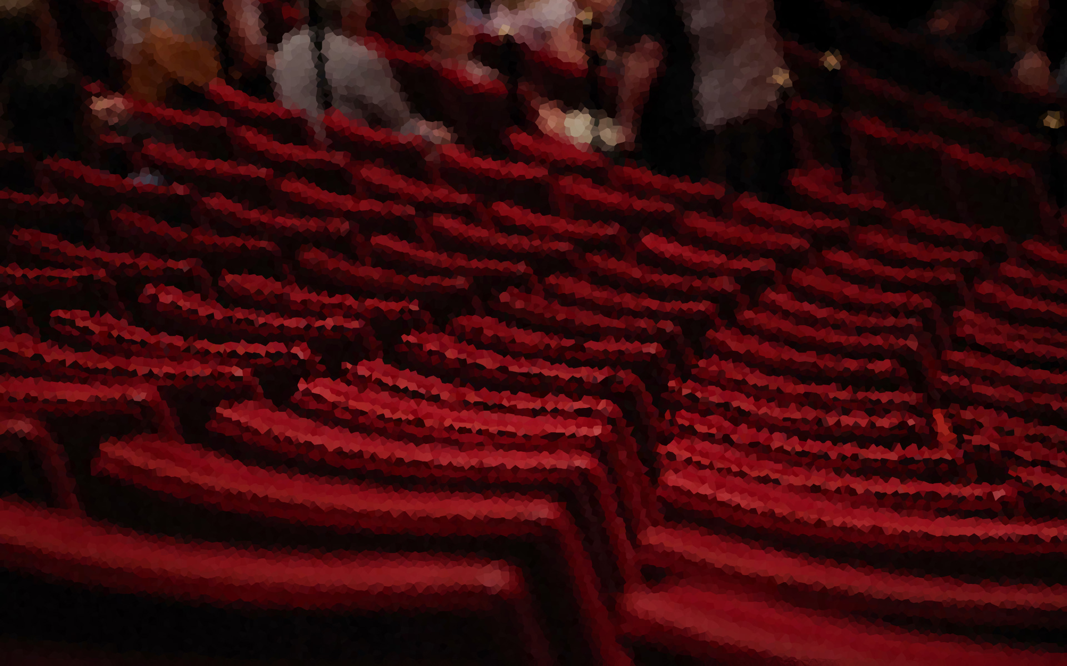
Agenda
Introduction
Related work
System description
Database
Experiments
Conclusions

Slide 4
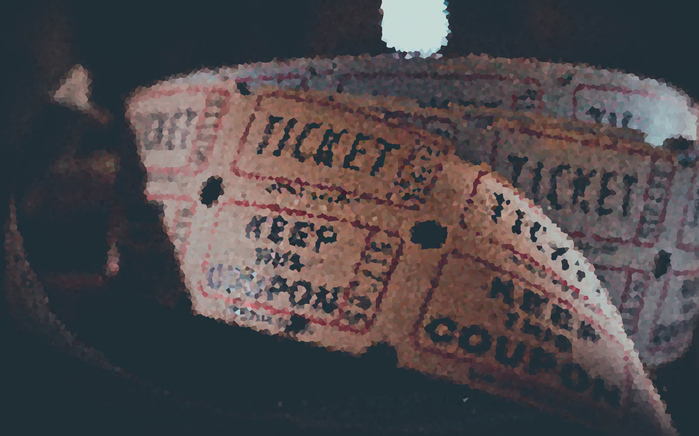
Introduction From movies to theatre
Movies
Audio signal is always the same.
The same information is always played in each new playback.
Variations related to playback speed and pitch.
Theatre
More complex scenario.
Audio signal varies from one show to another.
Variations related to script modifications, substitutions of actors, rhythm, speech cadence.

Slide 5





Introduction A lot of solutions for multimedia
Content recognition.
Synchronization through a second screen.
Song identification.
Lyrics synchronization.

Slide 6

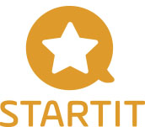

Introduction But there is a problem in theatre
Creation of captions.
Need of human intervention.
High costs.
Subtitling synchronization in theatre is not yet automated.

Slide 7
Goal
The definition of a real-time procedure to synchronize the playback of subtitles in a theatre play.

Slide 8
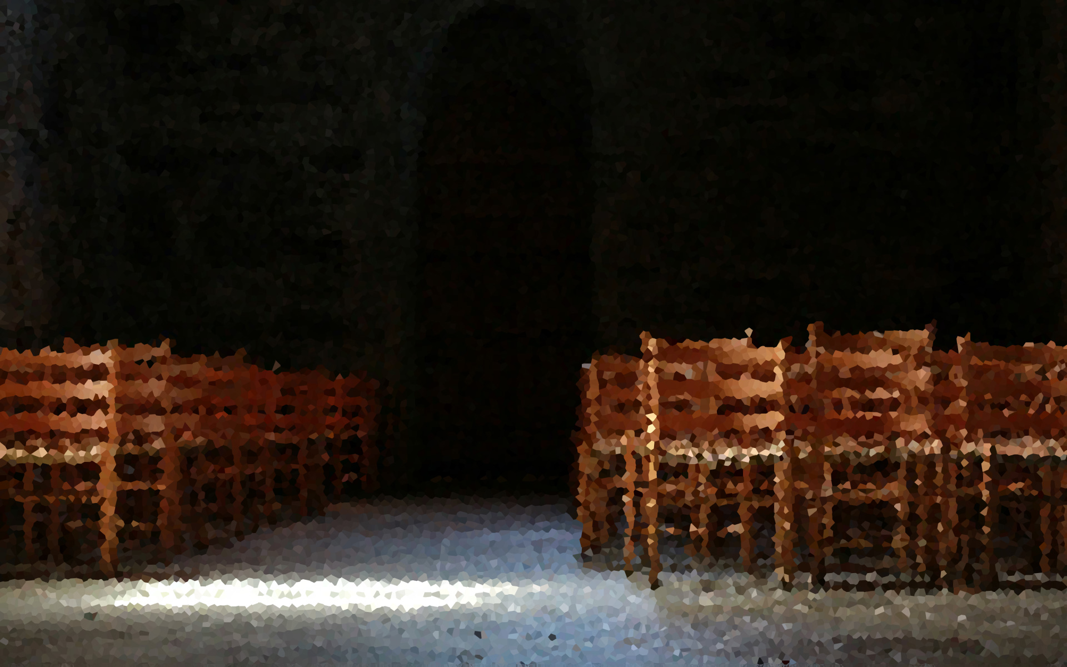
Related work Correlation
A measure of similarity is computed.
Some kind of distance function, typically the cross-correlation.
Very slow given its high computational load.

Slide 9
Related work Dynamic Time Warping
Alignment of signals using dynamic programming techniques.
Specific feature space.
A distance function is defined to determine the similarity.
Set of restrictions.

Slide 10
Related work Acoustic Fingerprint
Compact representation in form of content-based summary.
Uniquely represents an audio signal.
High discrimination, ease of storage, scalability and robustness.

Slide 11
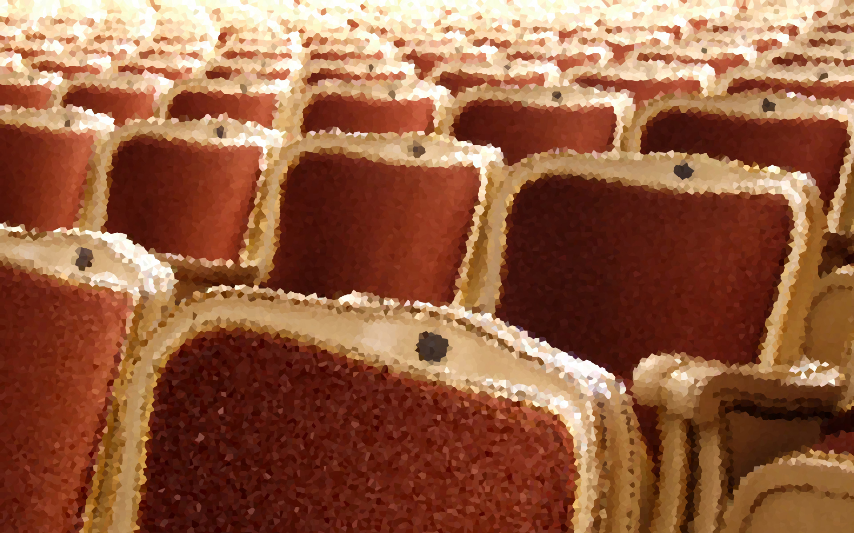
System description Overall description
Problem of Automatic Content Recognition.
It is not about identifying a multimedia content but a fragment of the theatre play.

Slide 12
System description Image generation
“SIFT-based local spectrogram image descriptor: a novel feature for robust music identification”

Slide 13
System description Audio characterization: SIFT
Find a robust feature space.
SIFT-Transform.
Artificial vision problem.
Notes:
Fingeprint extraction

Slide 14
System description Indexing and searching: LSH
Efficient approximation to nearest neighbour search.
Two similar points 𝒑 and 𝒒 in an input space can be hashed into the same bin with high probability.
Two parameters:
Number of tables (𝐿).
Hash function length (𝑘).
𝐾 partial LSH indexes: one for each indexed audio fragment.
Search in a range within 2 minutes.

Slide 15
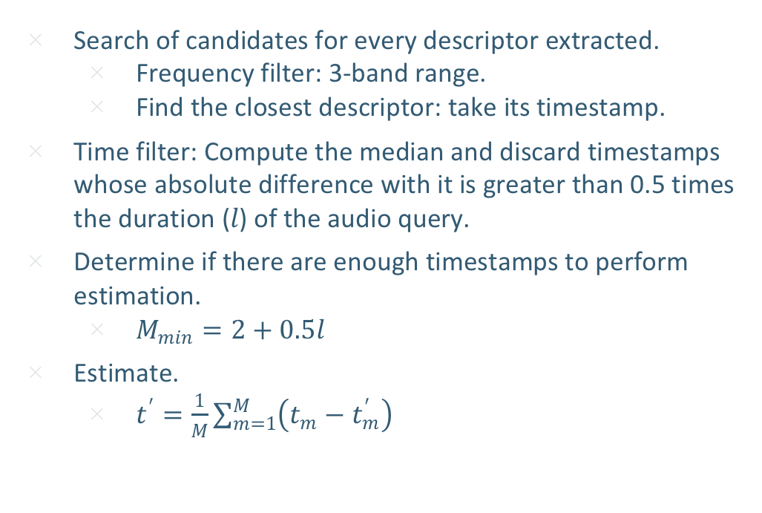
System description Timing estimation
Search of candidates for every descriptor extracted.
Frequency filter: 3-band range.
Find the closest descriptor: take its timestamp.
Time filter: Compute the median and discard timestamps whose absolute difference with it is greater than 0.5 times the duration (𝑙) of the audio query.
Determine if there are enough timestamps to perform estimation.
$M_{min}=2+0.5l$
Estimate.
$t^{′}=\frac{1}{M}\sum_{m=1}^{M}{\left(t_{m}−t_{m}^{′}\right)}$
Notes:
Fingeprint extraction

Slide 16
Database Limited availability of data
Lack of existing databases.
Ad-hoc database.
Five recording sessions.
Three audio sources for every session.
15 audio recordings.
Manual labelling and pre-processing.
“Cinco horas con Mario” by Miguel Delibes.
Several days of July 2019.
“Teatro Bellas Artes” in Madrid.
Notes:
Fingeprint extraction

Slide 17
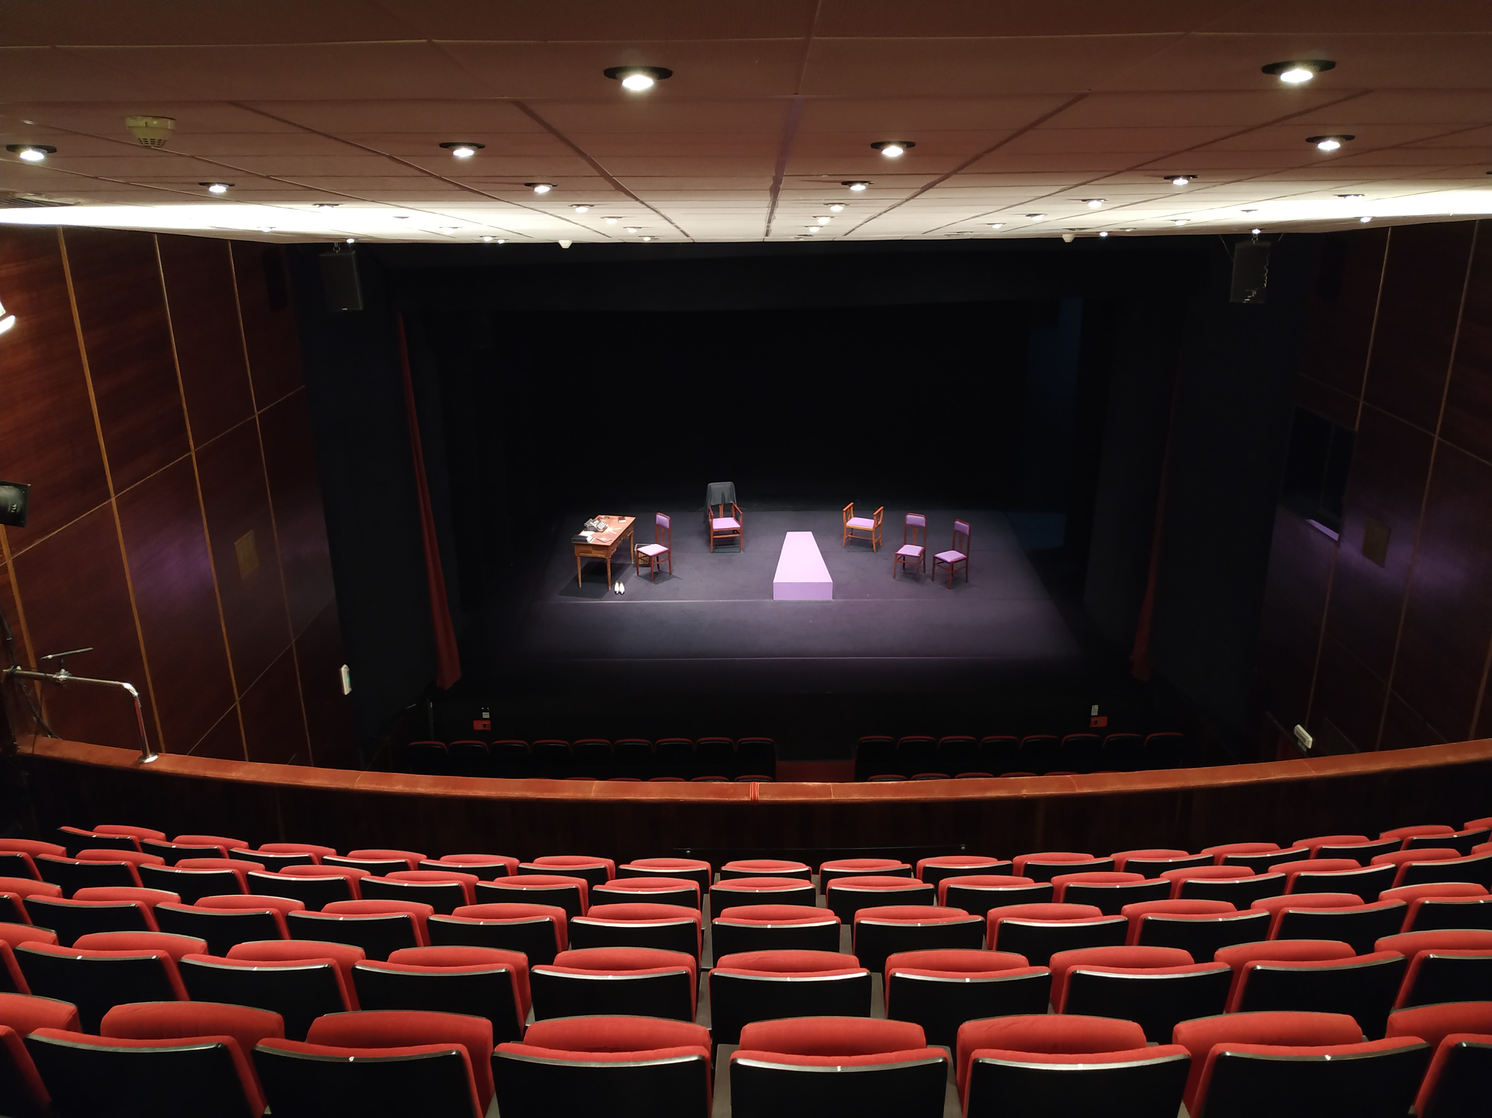
Source 1
Omni-directional head microphone.
Source 2
Hyper cardioid microphone.
Source 3
Stereo omnidirectional recorder.

Slide 18
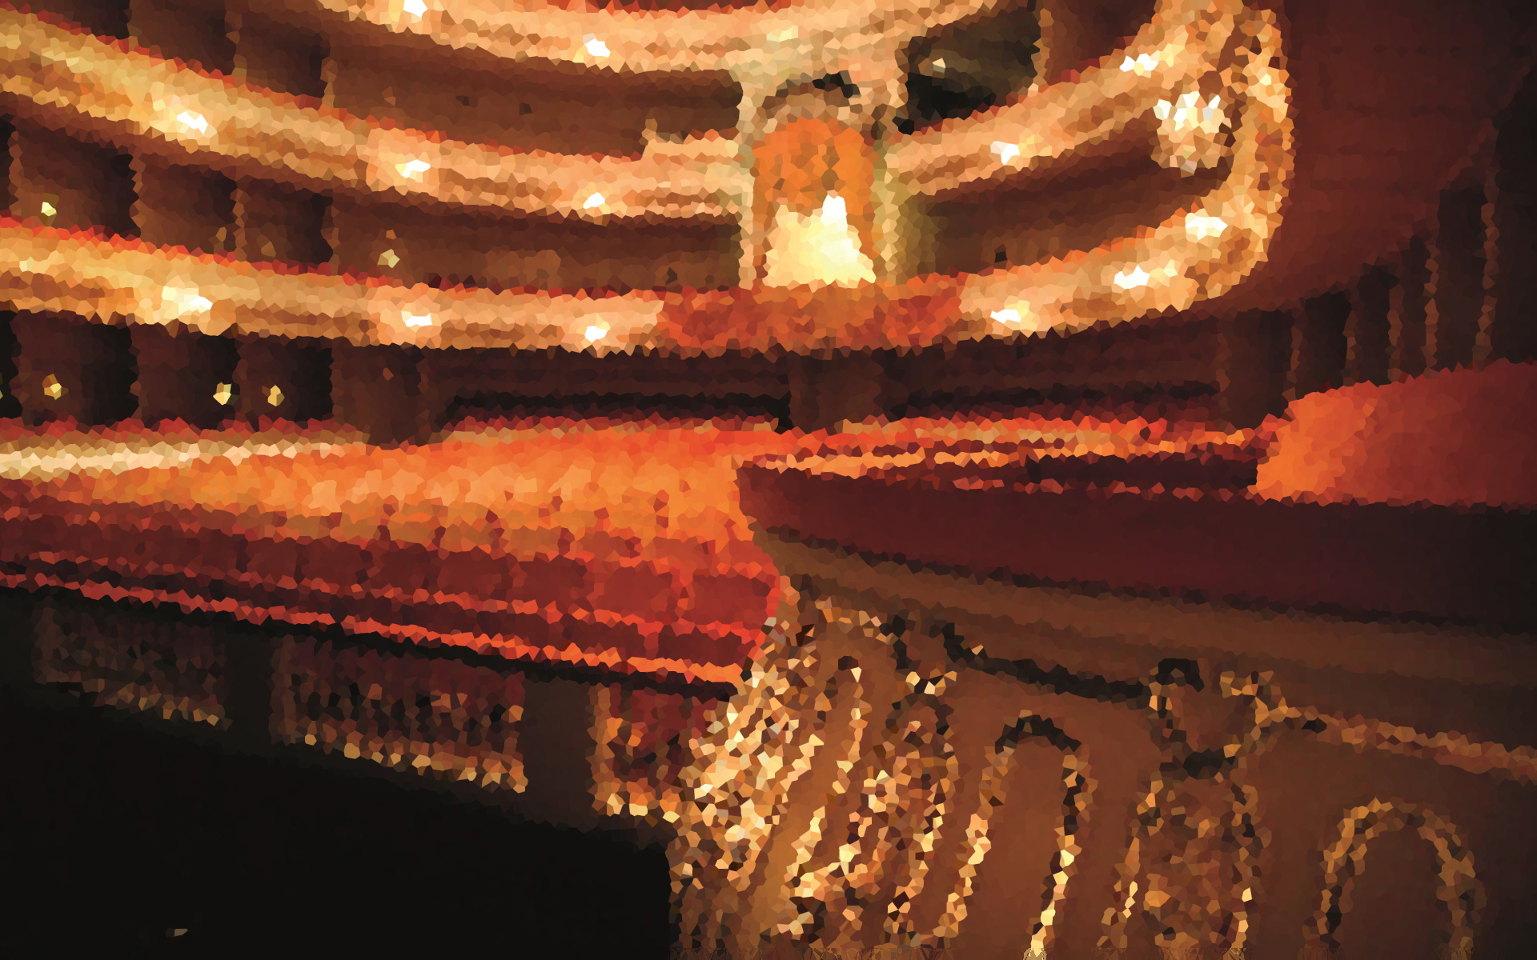
Experiments Methodology
Training file:
Indexed in fragments of 60 seconds.
Resulting database: 78 LSH partial indexes.
Measure of performance: Accuracy.
Fraction of fragments with respect to the total whose difference between the estimation and actual timing value is less than one second.
Every experiment was performed five times.

Slide 19
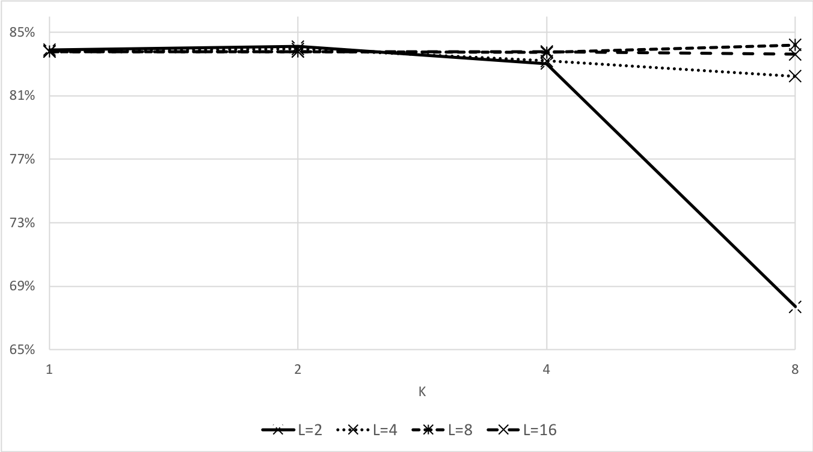
Experiments Influence of LSH parameters
Evaluation for different configurations of LSH: different combinations of parameters 𝐿 and 𝑘.
Audios belonging to source 1 using fragments of 10 seconds length as query.

Slide 20
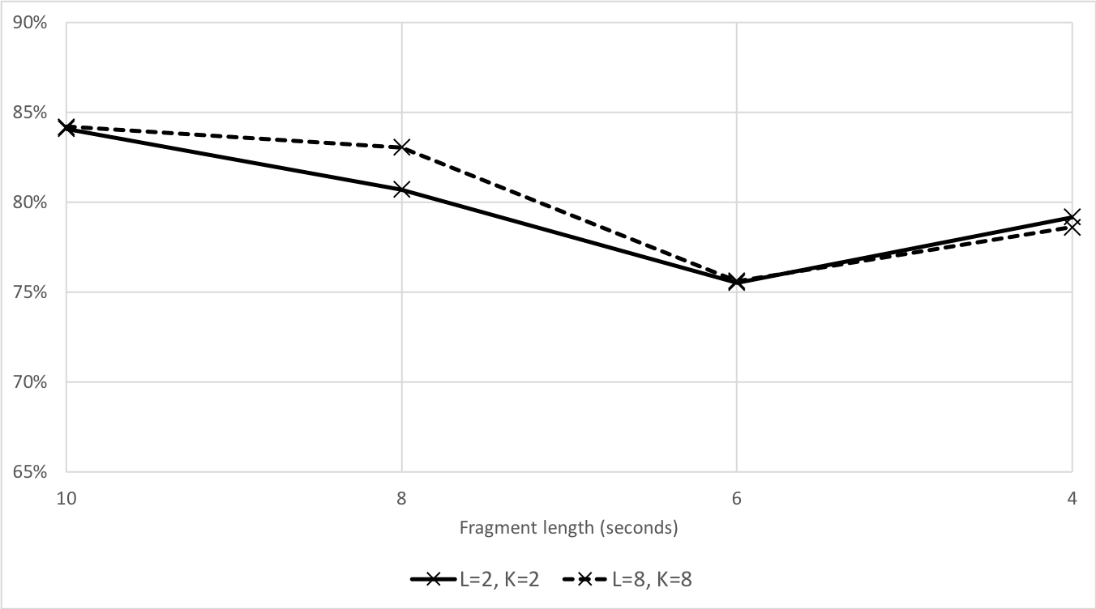
Experiments Influence of query length
LSH configurations {𝐿=2,𝑘=2} and {𝐿=8,𝑘=8}.
Audios belonging to source 1 using audio queries of 10, 8, 6 and 4 seconds.

Slide 21
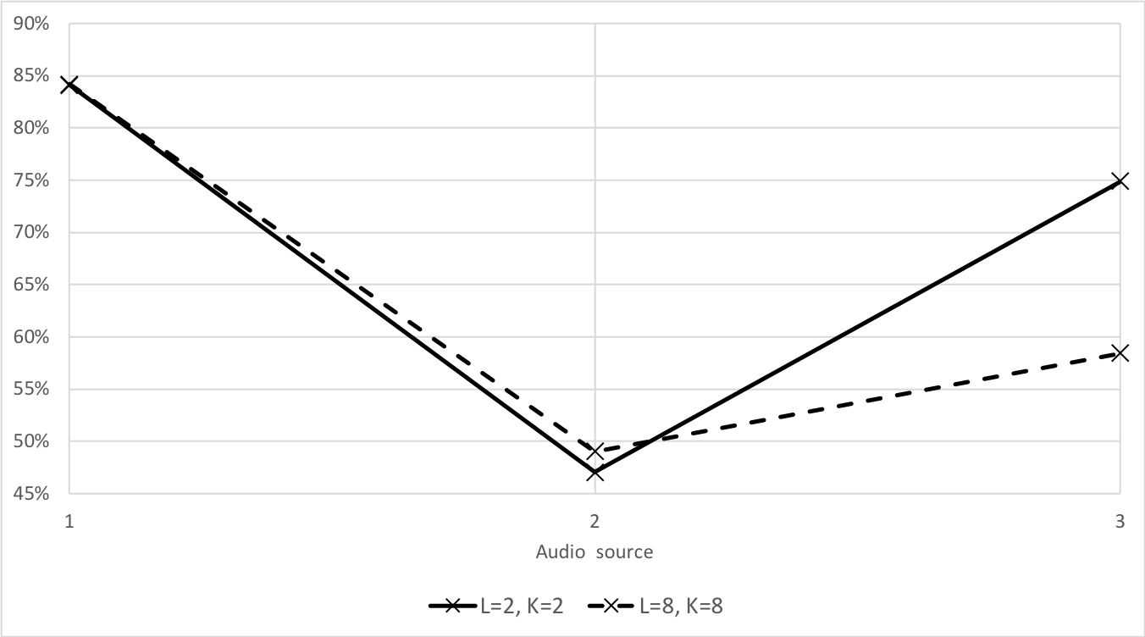
Experiments Influence of audio sources
Indexing: training audio from source 1.
Synchronization: testing audios from sources 1 (baseline), 2 (hyper-cardioid) and 3 (omni-directional).

Slide 22
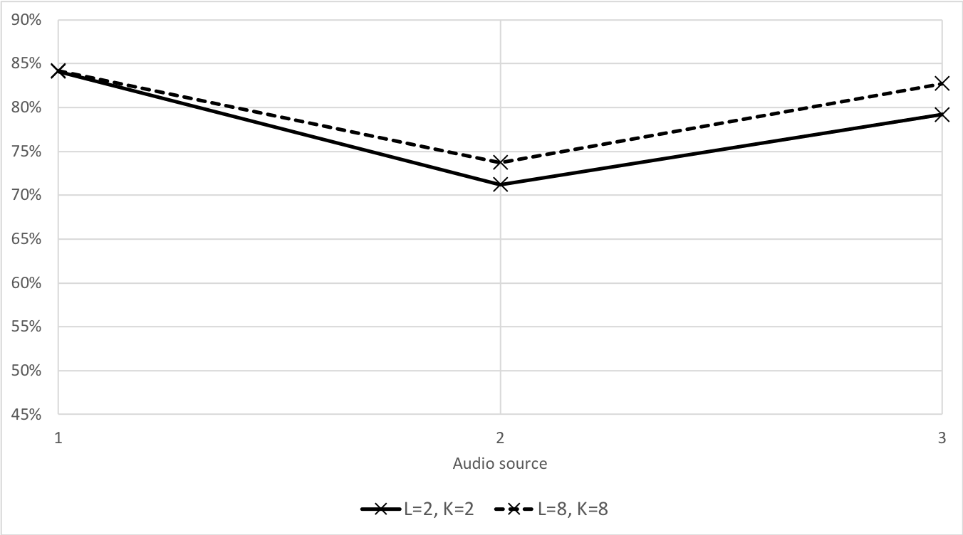
Experiments Influence of audio sources
Indexing and estimation has been done with the training and testing audios of the same audio source.

Slide 23
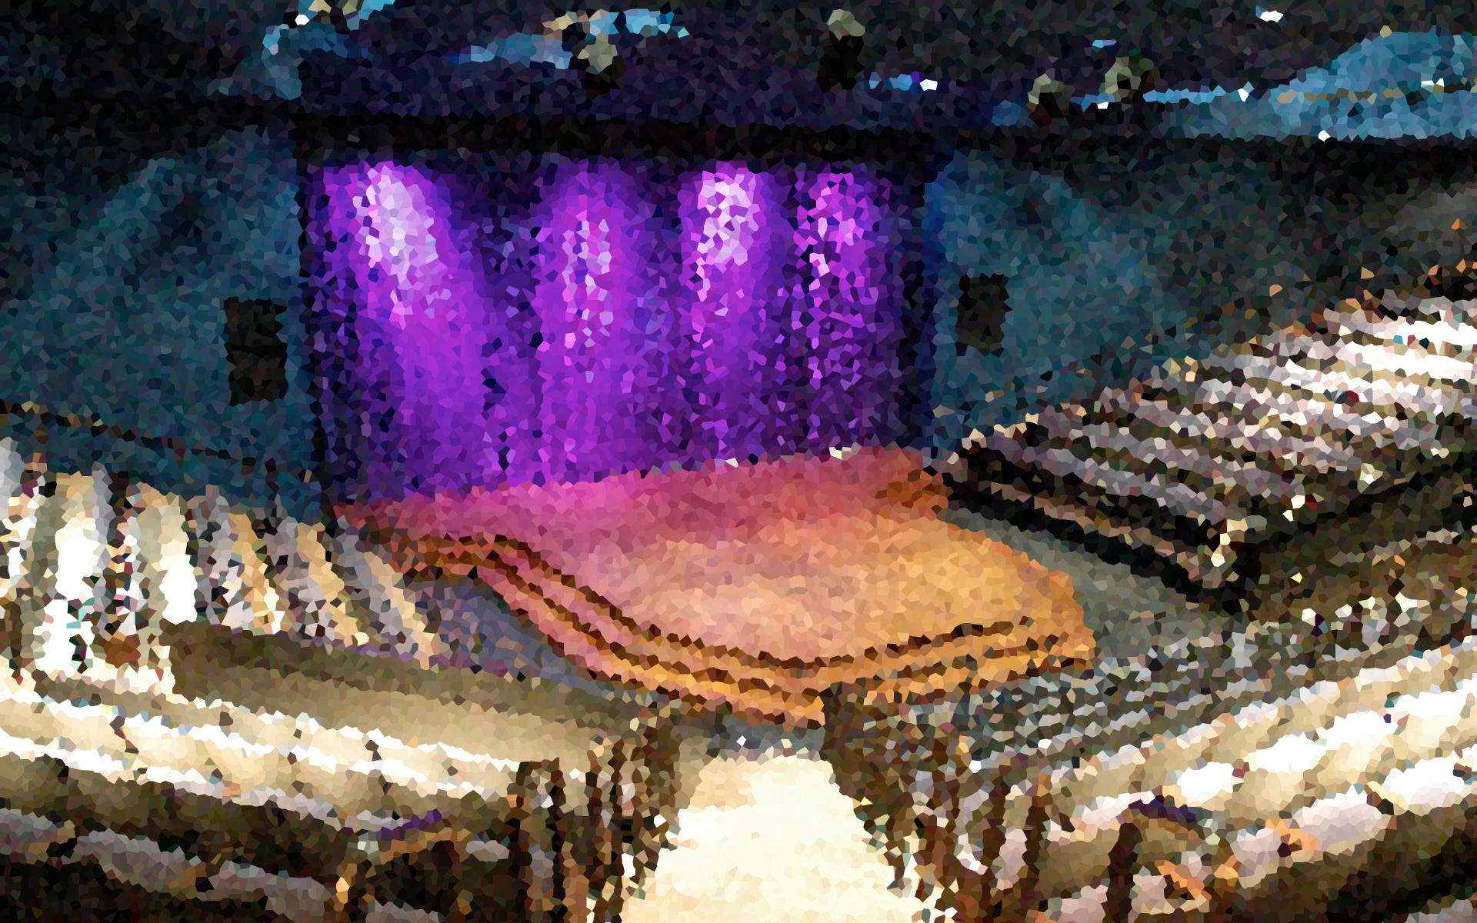
Conclusions Main ideas
The proposed system successfully synchronizes 84% of the audio
SIFT transform: have also demonstrated their application to the synchronization of audio sources.
LSH: small indexes are more efficient.
Dependencies on performance:
Acoustic conditions.
Acoustic similarities between indexing and estimation.
Stage coverage.

Slide 24
Conclusions Future work
To explore new procedures for estimating the playback timing.
To evaluate more extensively the performance of the system with other types of theatre plays.
To investigate in depth the characteristics and behaviour of the SIFT descriptors.
To develop a filtering mechanism to determine the ability of a descriptor to be indexed.

Slide 25
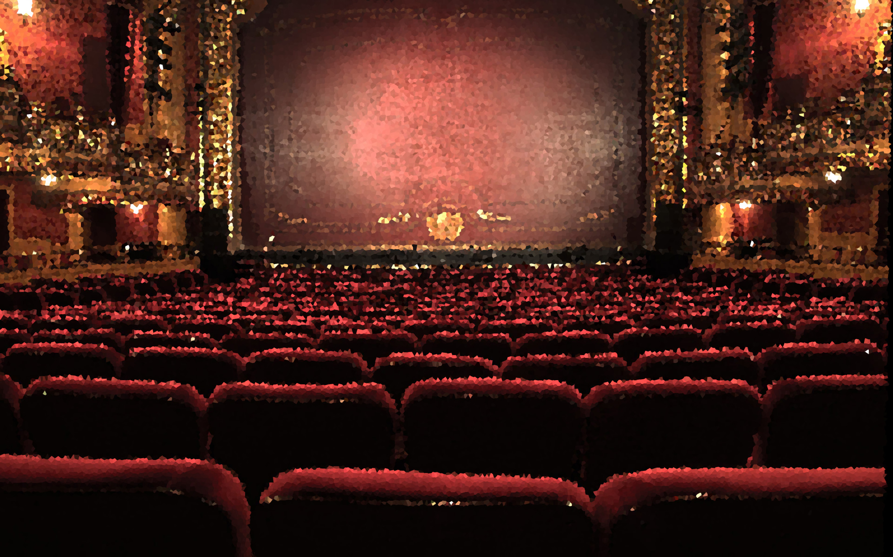
Thanks!
Any questions?

